Slide 1
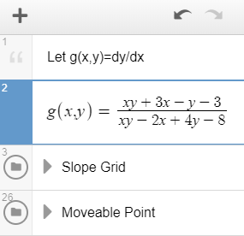
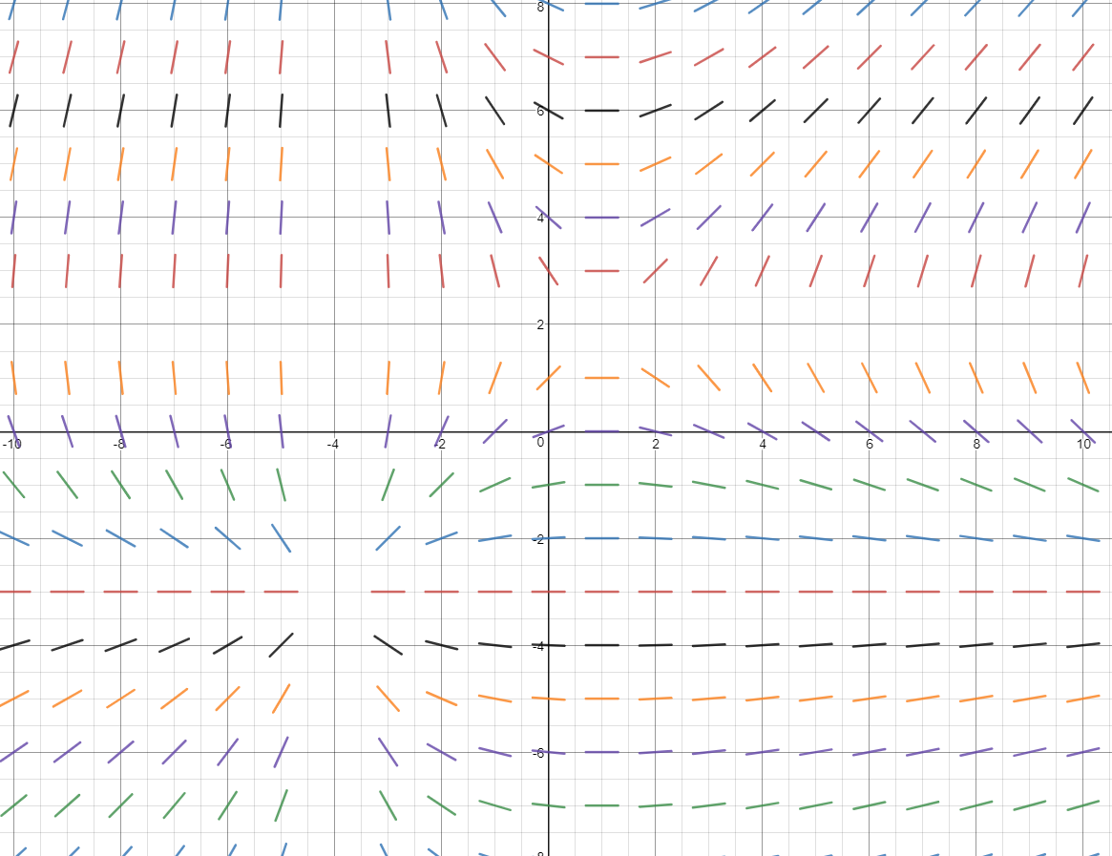
https://www.desmos.com/calculator/p7vd3cdmei

